Slide 1
Soft Robotic Arm ROCO504
By
Joshua Sullivan
Alex Rowe
Simon Walker

Slide 2
Introduction and Goals
Develop an arm that
Replicates the movement of a human arm.
Throws a projectile further than if the servos where statically connected to one another.
Uses 3D printer materials, designed on AutoDesk Fusion 360
Is comparable to a human arm.
Notes:
This project looks at soft robotics and how the sudden release of stored energy can help a robot arm throw a ball.
A human arm uses antagonistic muscle pairs to throw a projectile, we aim to replicate this with our robotic arm. This will allow the robotic arm to throw a projectile further than the servos could if in a direct drive system.
This is desirable as typically larger servos would be required that cost more, weigh more and take up a larger amount of space.

Slide 3
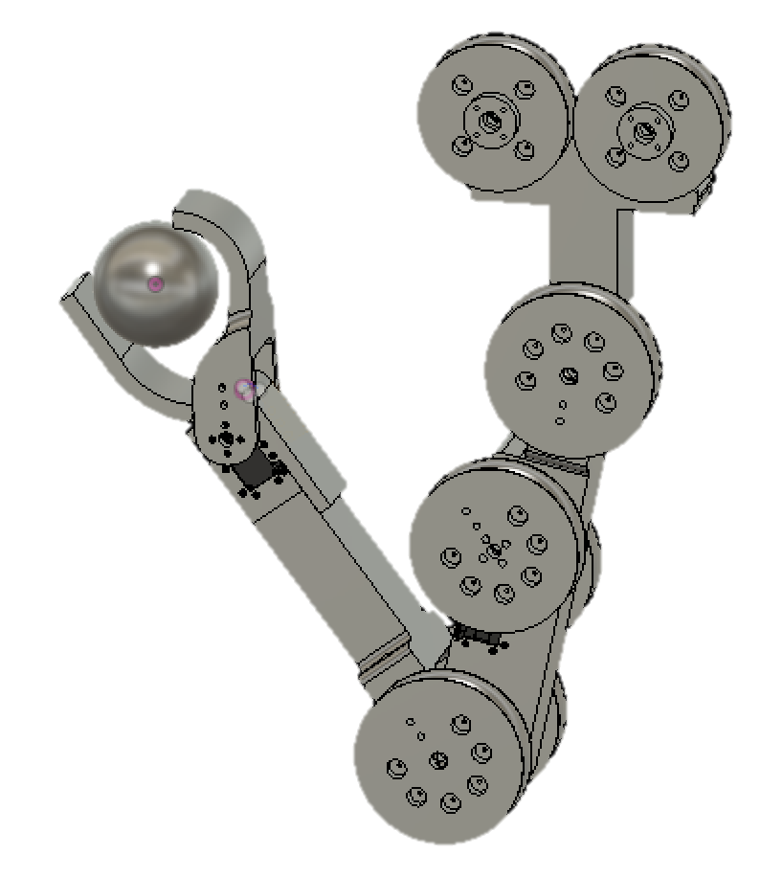
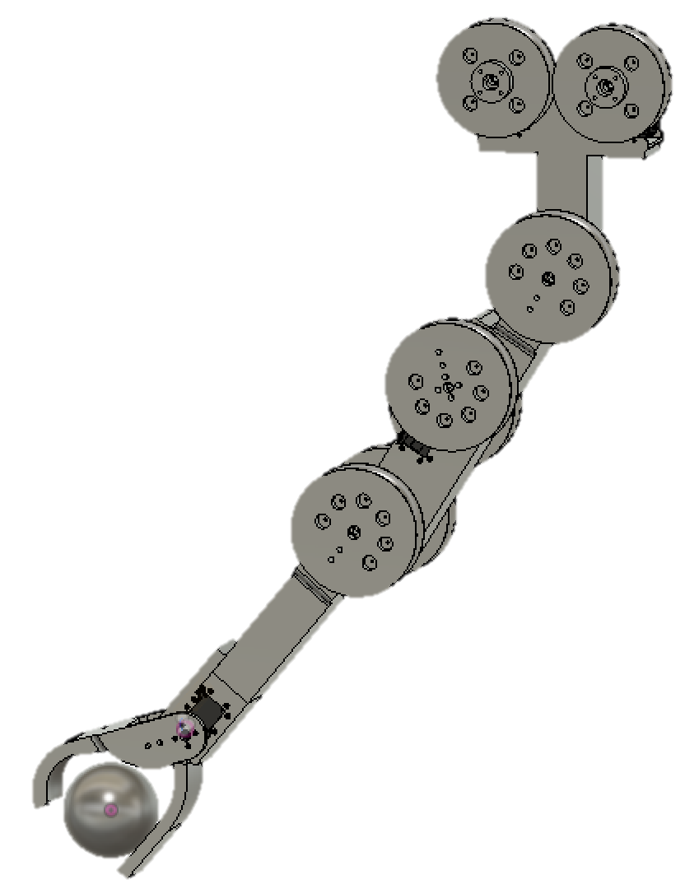
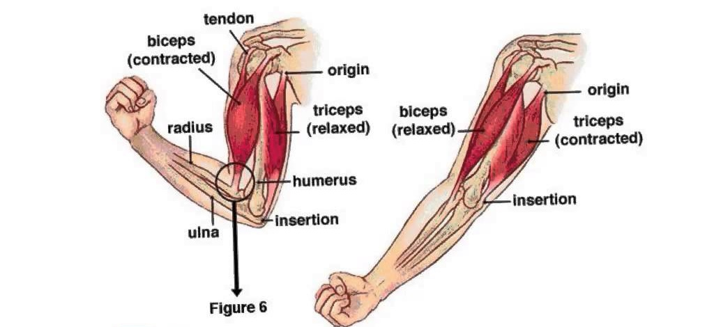
Antagonistic Joint Control
The Arm will use antagonistic muscle pairs that work opposing to each other to control the movement at the shoulder and elbow joint.
Notes:
Antagonisitc muscle pair
One contracts
One relaxes

Slide 4
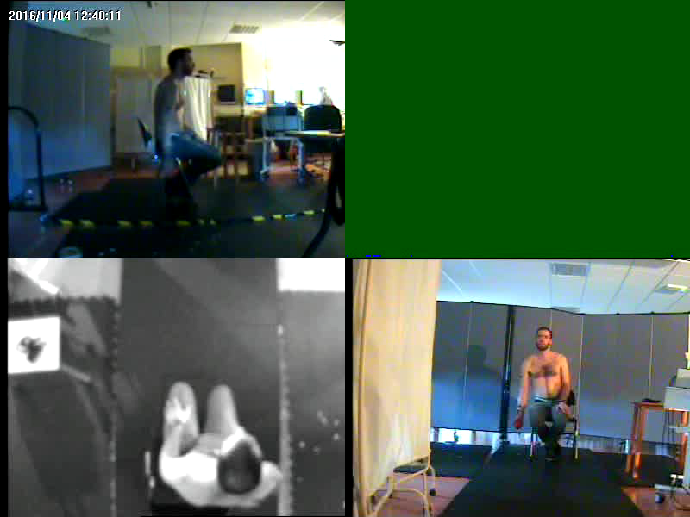
Human Movement and Function Laboratory
Notes:
Alex

Slide 5
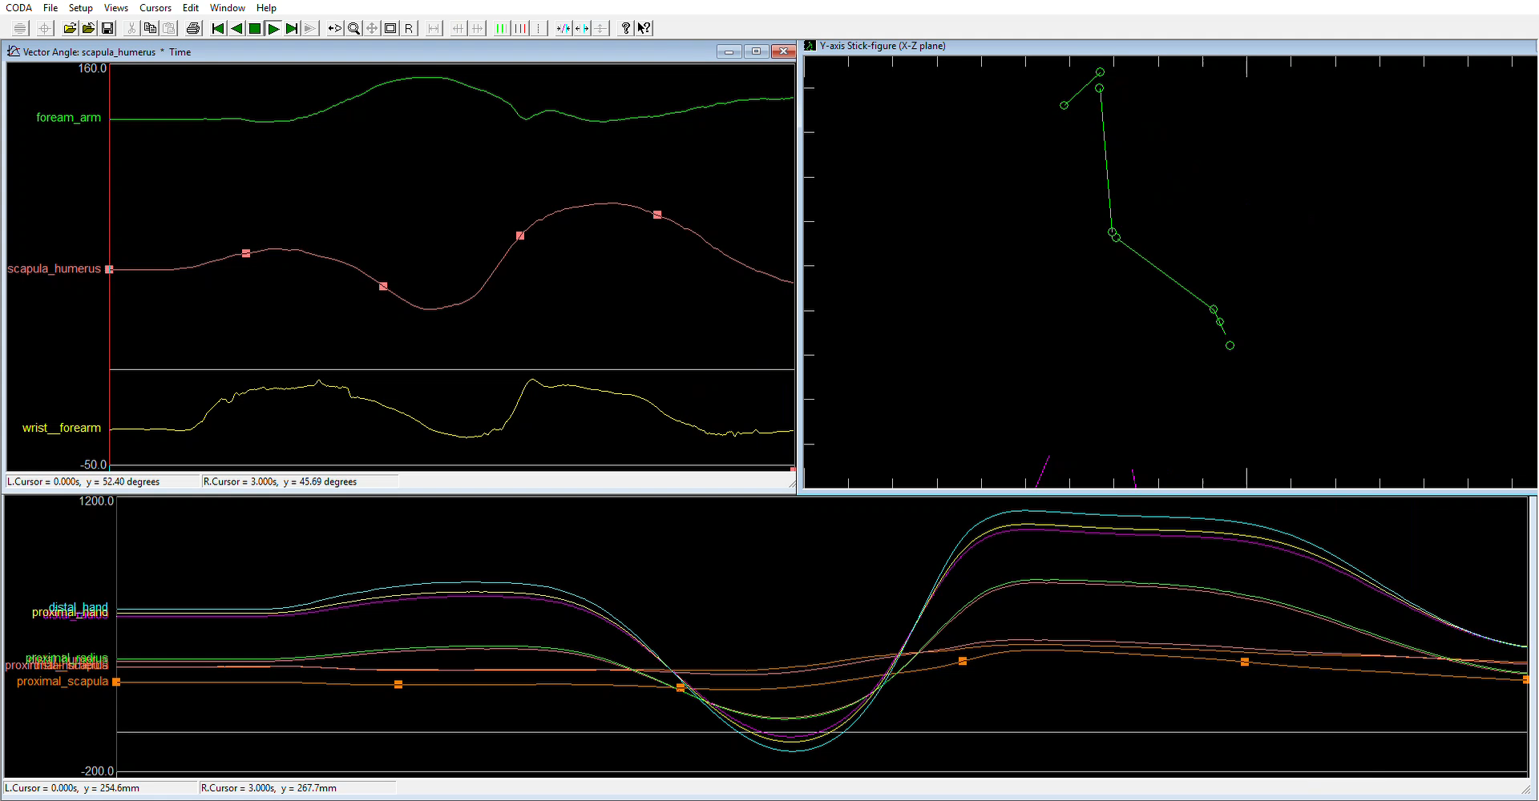
Notes:
Forwards 11 degrees

Slide 6
Data from the Gait Lab
θ
From the data collected, the peaks of three bumps were calculated. This gave us an angle to move the arm to for the swing.
Notes:
Simon

Slide 7
Robot swing Demonstration
Human Swing
Improved Human Swing
Future -
Rigid Swing for comparison
Computer learning

